Slide 1
Generative Adversarial Networks on CIFAR-10 Dataset
By:
Hazem Bin Ryaz Patel (2200550) &
Tan Yue Feng (2214478)

Slide 2
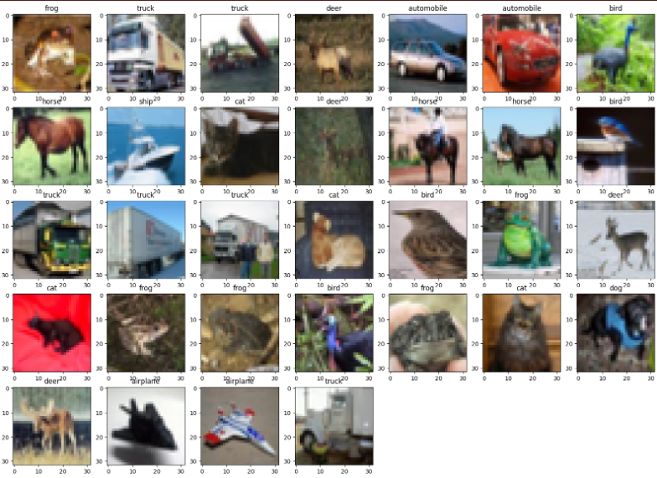
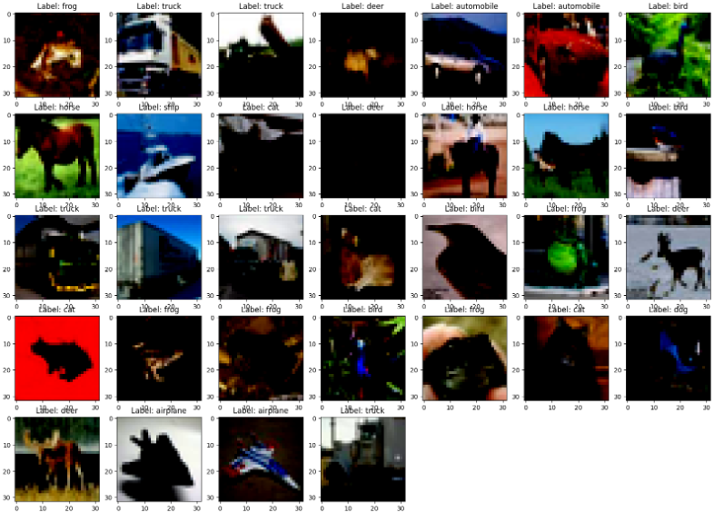
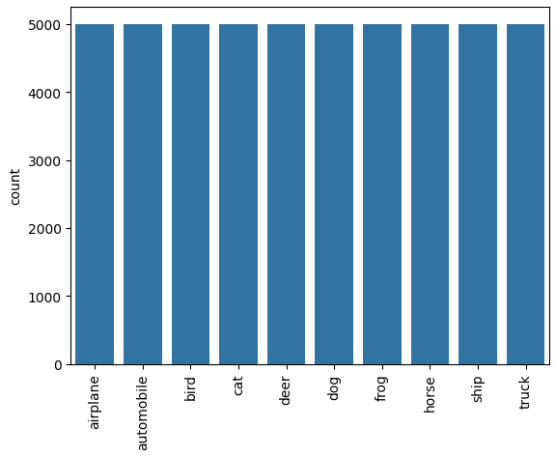
EDA: CIFAR-10
Normalize images to ensure consistency
Training set: 50000 images of 10 classes
Test set: 10000 images of 10 classes
Equal class distribution; 5000 images each
Original Images
Normalized Images

Slide 3
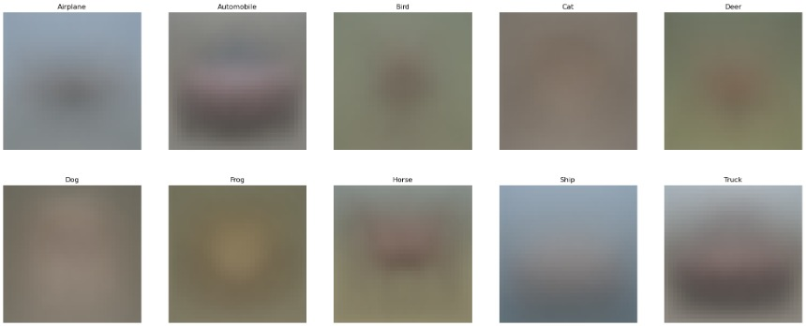
EDA:Pixel Averaging
Faint silhouette of vehicle classes, frogs and horses
Model likely to generate clearer images of these classes
Horse’s head seems to generally be in left side of image; apply horizontal flip

Slide 4
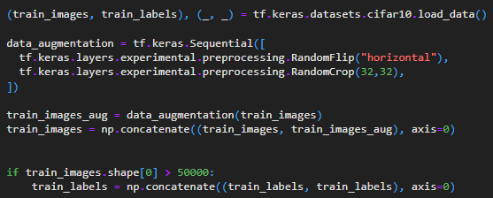
Feature Engineering: Data Augmentation
Concatenate train and test (not recommended)
Random horizontal flip
Random crop
Final image dataset: 120,000 images

Slide 5
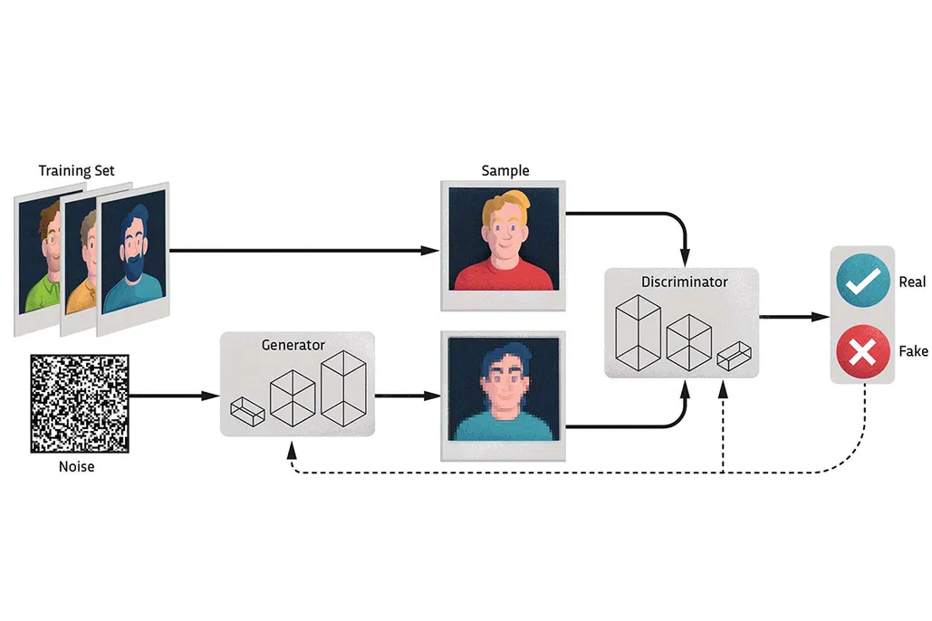
How GANs work
2 NNs: Generator (G) and discriminator (D)
G aims to generate fake images that appear real enough to trick D
D aims to distinguish real and artificial images
2 models compete to see which one’s better

Slide 6
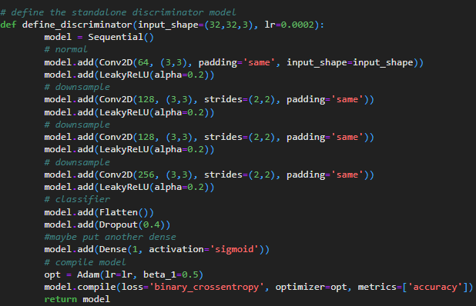
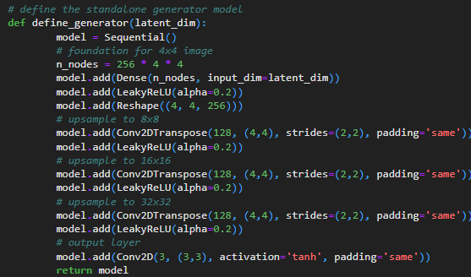
Baseline Model: DCGAN
Architecture
Discriminator (D)
4 Conv2D layers with
LeakyReLU
Dropout of 0.4
Adam optimizer with
0.0002 lr
BCE loss
3x3 kernel, stride of 2
Generator (G)
3 upsampling
Conv2DTranspose
layers with LeakyReLU
4x4 kernel, stride of 2
Training Process
For every epoch, train on batches of 128
For each batch, train D on ½ batch (64) of real images, then ½ batch of fake images generated by G
Update G via D’s loss, feeding 1 batch (128) of latent noise and fake ‘real’ labels to GAN
G and D perform in tandem, never crashes (one doesn’t outperform another)

Slide 7
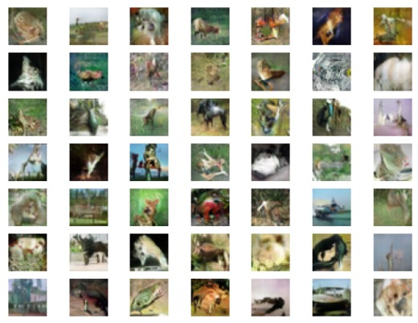
Baseline Model: DCGAN Evaluation
Scoring
Inception Score: how many distinguishable classes InceptionV3 model predicts there is without being given labels (max score: 10 for 10 classes); gives idea on how well GAN performs
Baseline model inception score: 3.2/10 on 5000 images with ~0.4 std.
Inception model is not sure whether there are 2 or 3 unique classes
Sample images look somewhat distinguishable; but not clear enough
Sample images:

Slide 8
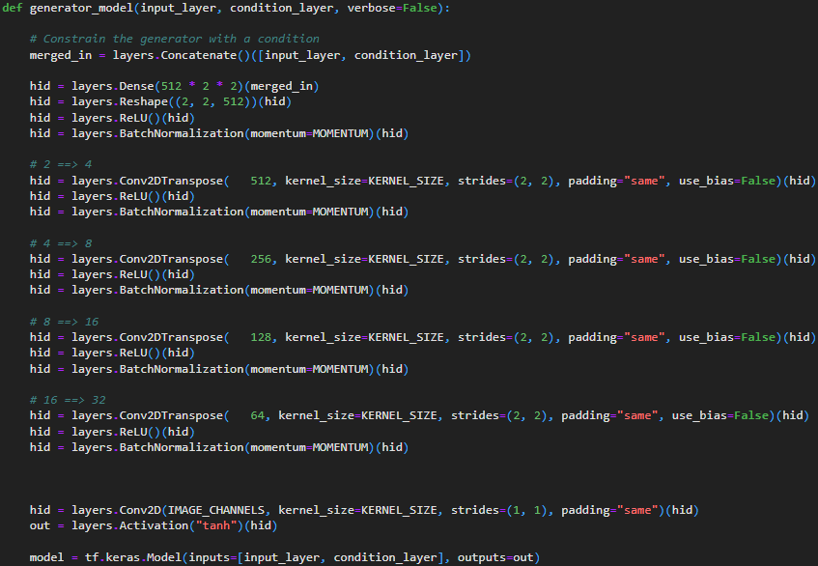
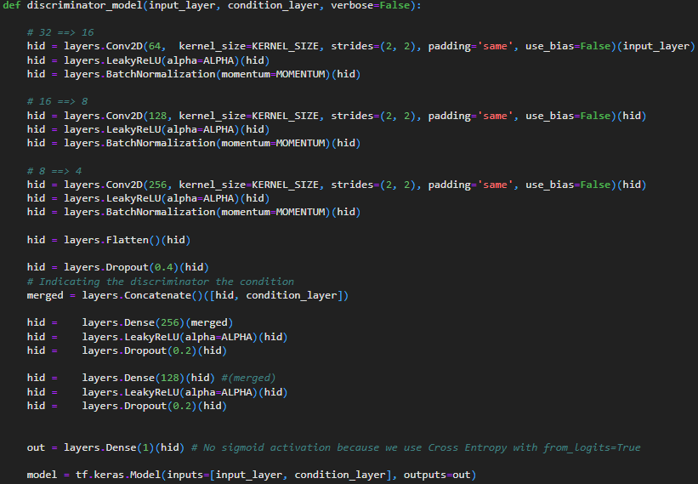
Model Improvement: DCGAN with One-sided Label Smoothing
Changes
Constrain generator with condition (number of classes), similar to cGAN
One sided label smoothing on discriminator:
Prediction of real images decreased to 0.8 from 1
Prediction of fake images kept at 0
Increases training stability + regularizes discriminator
Halved learning rate of discriminator to 0.0001
Removed half-batch training; riskier but better potential results
Applied BatchNormalization for both generator and discriminator; helps stabilize the training process

Slide 9
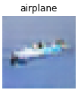
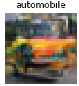
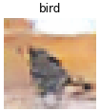
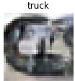
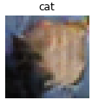
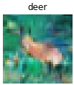
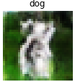
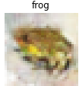
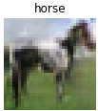
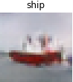
Model Improvement: DCGAN with One-sided Label Smoothing
Sample images look a little clearer than previously, although still rather unclear
Inception Score: ~4.5/10 on 5000 images with 0.14 std
Statistically, model performs better as well
Inception model is also more sure there are about 4 unique classes

Slide 10
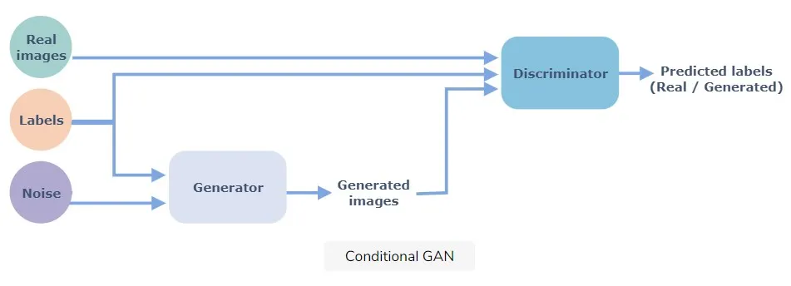
Model Improvement: cGAN
Conditional GANs embeds encoded class labels with images as input
Enables more precise generation and discrimination of images to train machines

Slide 11
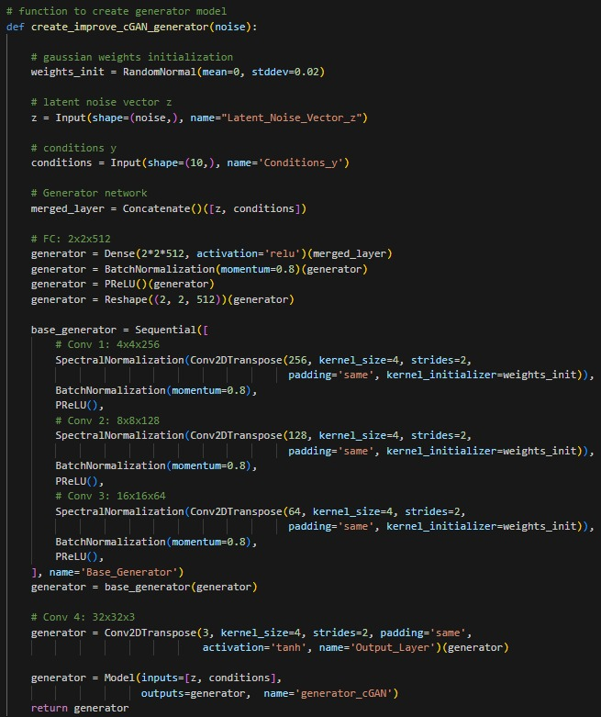
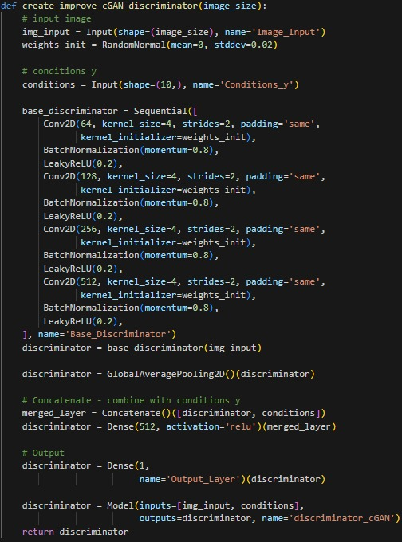
Model Improvement: Improved cGAN
Changes
Gaussian weights initialization
Embedding layer for classes
Implement PReLU for generator
Implement SpectralNormalization for generator
These solve exploding gradient issues
Use of KL Divergence loss; how similar generated images are to real images

Slide 12
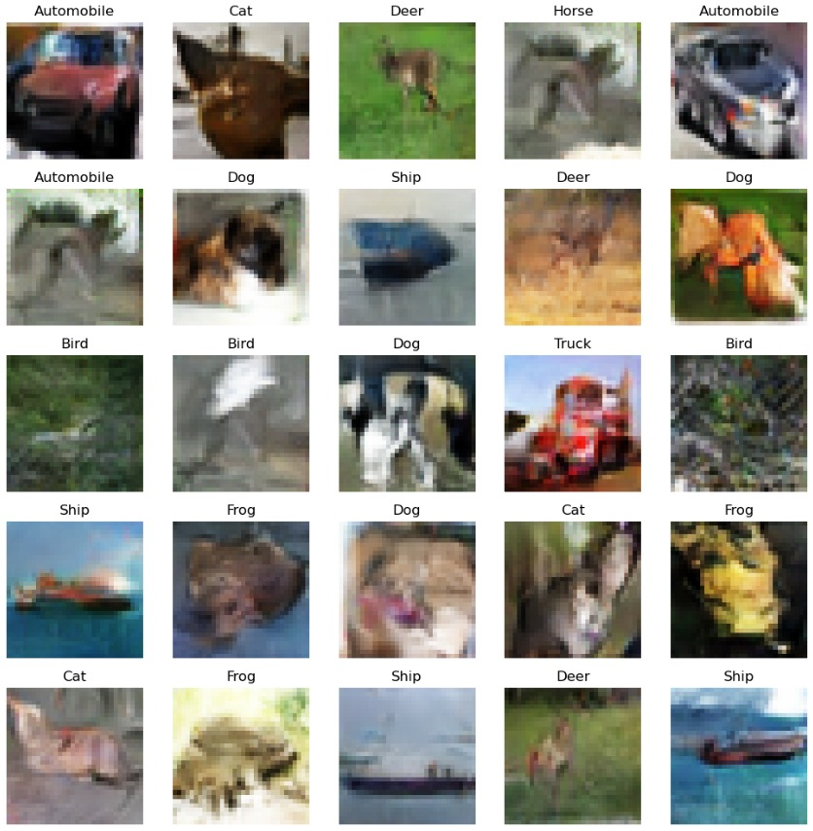
Model Improvement: Improved cGAN
Sample images start to look distinguishable, especially dogs, cats, deers and vehicles
Horse appears to have crashed
Inception score: ~5.11/10 for 10,000 images, the best so far, with 0.1 std
Inception model’s confident that there’s 5 unique classes

Slide 13
Conclusions and areas for improvement
Statistically, cGAN performs best, having an inception score of 5.1
Visually, cGAN also has the clearest images, although it crashes for horse images
cGAN seems to be too complex to generate classes with easier patterns
This can be mitigated by loading earlier epoch weights, or adding further regularization / dropout
Modified DCGAN also performs rather well, but is more inconsistent
Implementations have been successful in improving performance of GAN model
Models could be run for more epochs, better/more augmentations

Slide 14
Reinforcement Learning
Gym’s Pendulum
By:
Hazem Bin Ryaz Patel (2200550) &
Tan Yue Feng (2172268)

Slide 15
Table of Content
01
03
02
06
04
05
Background Research
SECTION
SECTION
SECTION
SECTION
SECTION

Slide 16
01
Background Research

Slide 17
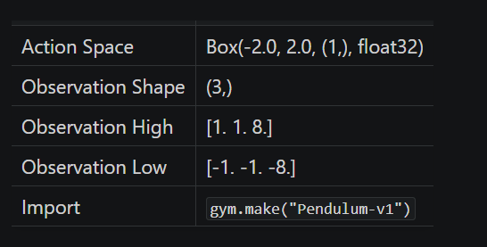
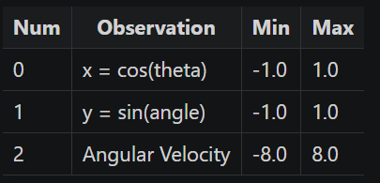
Observations (Research)
Action Space, it’s continuous with a range of (-2,2)
Need to Discretize. (2 Methods)
Define Action Space LinSpace(-2,2, NAction)
Conversion w Normalization
Observation Shape, High , Low
Observation represents the x-y coordinates of the pendulum’s free end and its angular velocity.
Reward Calculation
r = -(theta2 + 0.1 * theta_dt2 + 0.001 * torque2)
Min is -(pi2 + 0.1 * 82 + 0.001 * 22) (angle is normalized between [-pi, pi]
Range is (-16.2736044, 0)

Slide 18
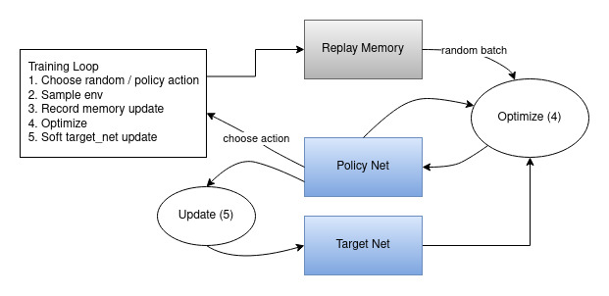
What is a DQN:

Slide 19
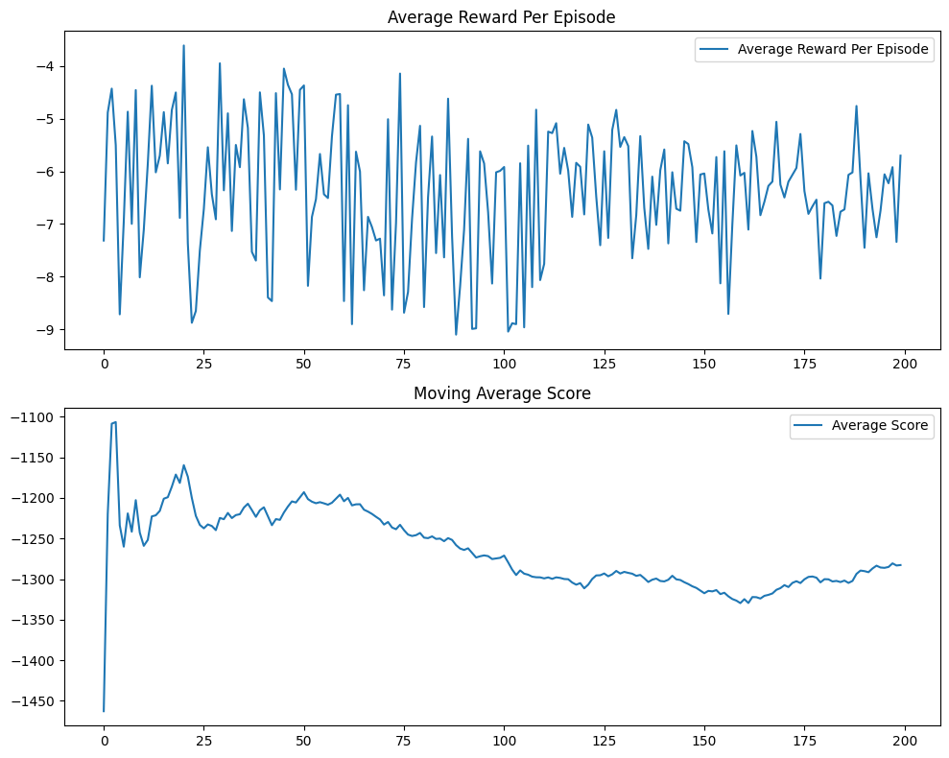
Initial Approach
Initial Results and Graph
Normal DQN transformed to handle pendulum:
Some approaches taken include:
Discretize Torque with LinSpace - handles continuous action space
Take argmax of the q-value and reference discrete action space
Pass Torque Value to Env.Step()
Append Torque to memory
Train (Epsilon Decay Every Episode)
*Used Model.Fit(), took a long time
Default Params:
Learning Rate - 0.01
Epsilon Decay - 0.99
NActions - 10
*Average Reward/ Episode used instead of Score. This was switched later.
After tuning parameters, results didn’t improve. Graphs available in .ipynb

Slide 20
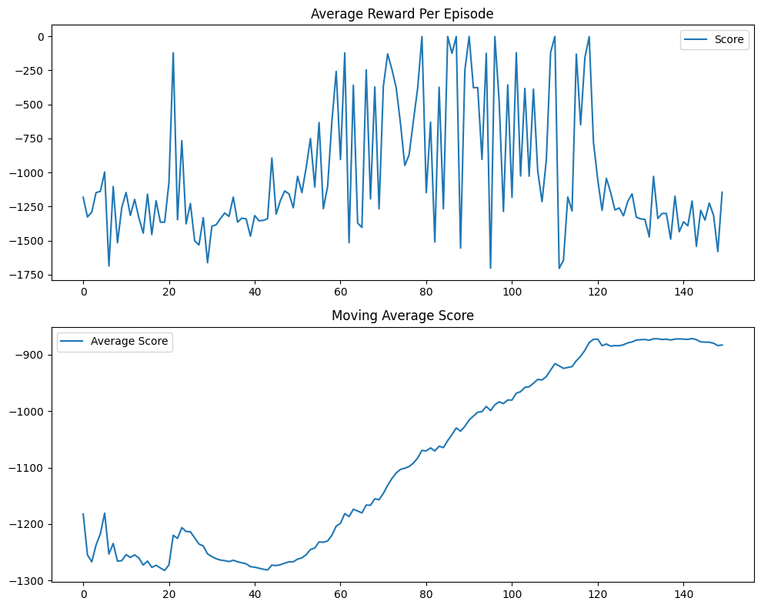
Revised Approach
Untuned Results and Graphs
Seeing the Initial Approach Fail, Adjustments Were Made:
Implement Target Model
Appended Index instead of Torque Value to memory
Increased Memory Length to 10,000
Torque Value calculated using converter
Used Gradient Tape to increase the learning speed
Observations:
Model would learn to solve the problem but would fail right after (Highly Unstable)
Towards the end of the Episodes, model would “crash” and not recover

Slide 21
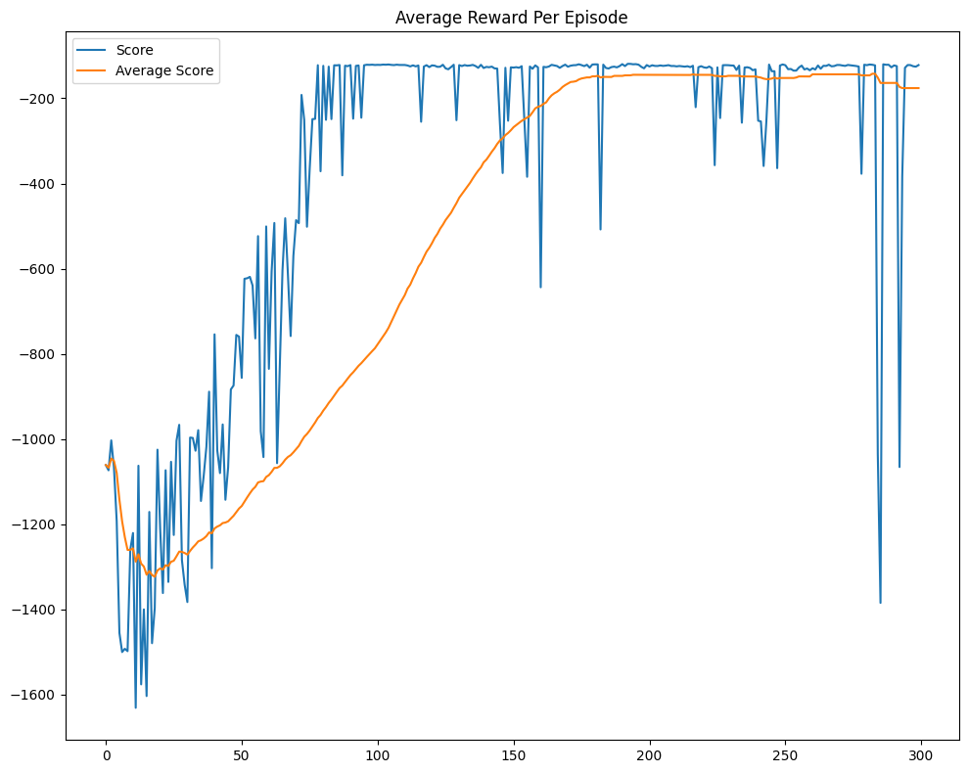
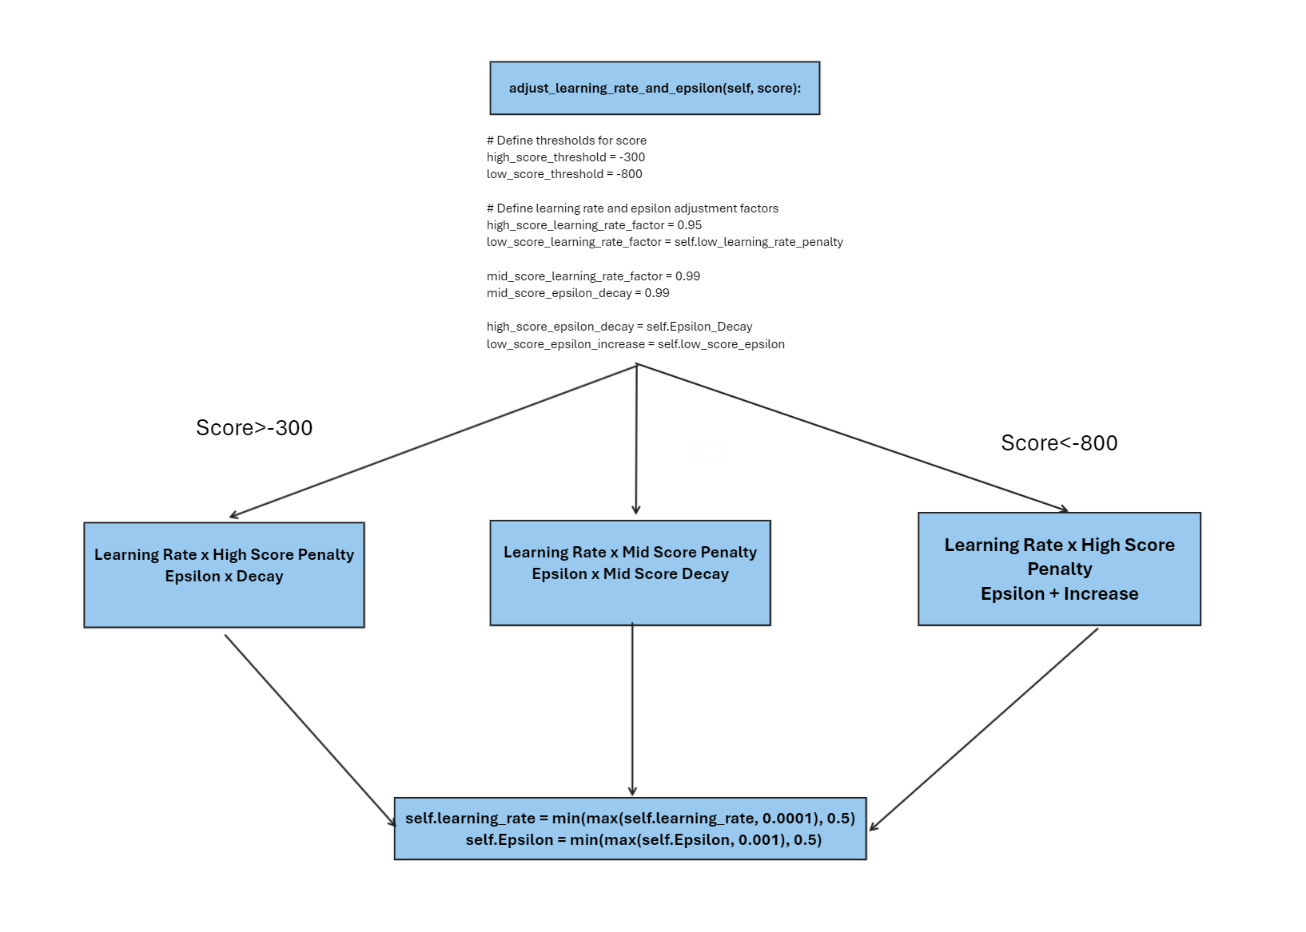
Solving the instability problem
Instead of having a fixed decay for Epsilon and Learning Rate,
We opted for a dynamic Learning Rate and Epsilon that adjusted based on the current Score
This allows for a more stable training, reduces the chances of agent jumping out of a solve and the model crashing. The new base model is as shows:
Downside: Model can get stuck in a local optima, we decide that consistently solving it was better than an unstable model

Slide 22
Tuning [Can Choose to Switch Back to Code]
Metrics for Evaluation: [Weights were loaded in for each tune for evaluation]
Number of Episodes taken to converge
Dips in performance and Moving Average
Hyperparameters tuned: (In order of subjective importance)
Number of Discretized Actions
Discount Factor
Learning Rate & Epsilon Decay Adjustments
Memory Length
Update Target / Episode
Normalized Rewards (In a separated .ipynb file - takes a long time)

Slide 23
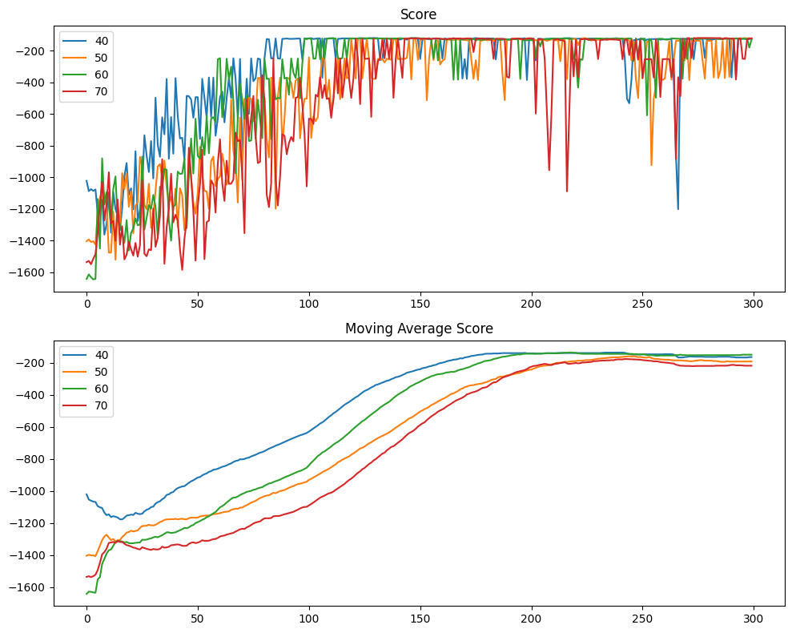
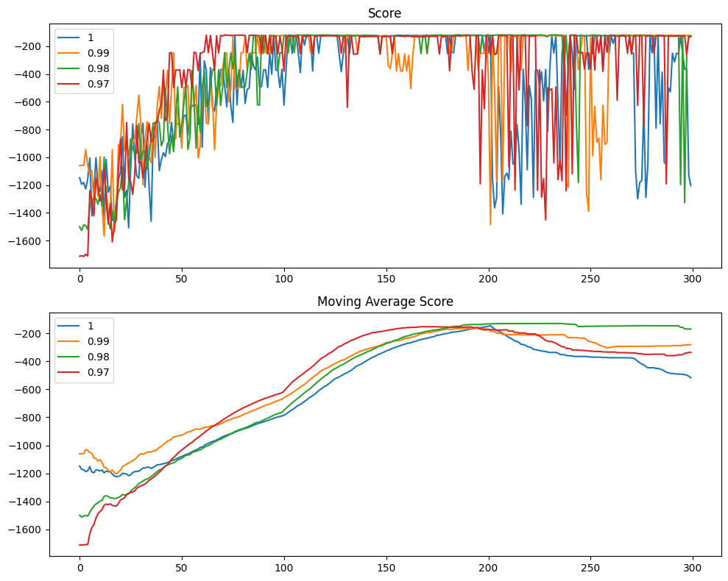
Tuning (1) - Number of Actions, Discount Factor
Number of Discretized Actions:
NActions = [40, 50, 60, 70]
Discount Factor:
Gamma = [1, 0.99, 0.98, 0.97]
Observations:
As the number of actions increase, the more unstable it becomes
40 Actions convergest the quickest and is most stable
Gamma of 0.98 is a sweet spot for considering future rewards.
Although not a significant difference, we found that it was the best balance between future and immediate rewards.

Slide 24
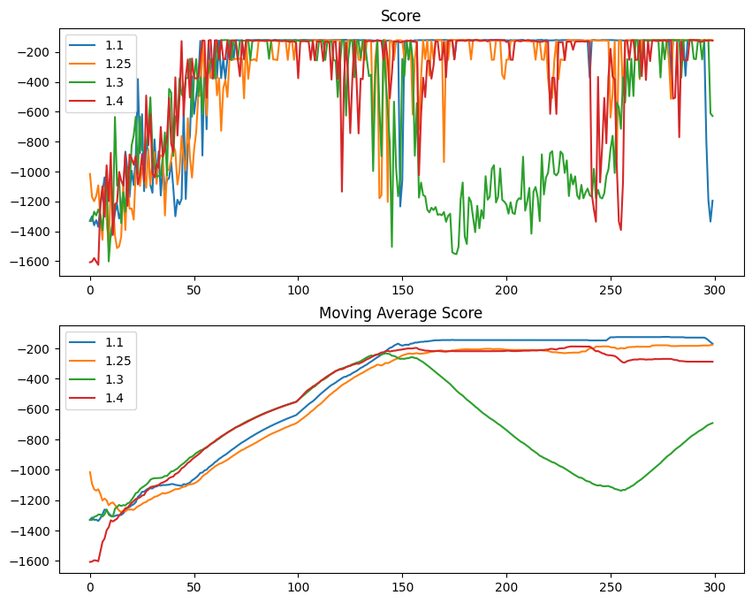
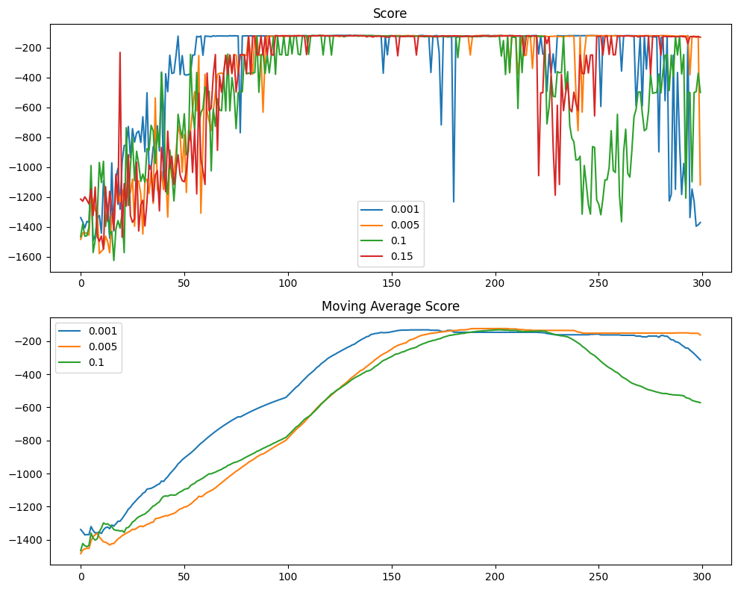
Tuning (2) - Learning Rate & Epsilon Adjustment
Low Score Learning Rate Penalty:
Low_Score_Learning_Rate =
[1.05, 1.25, 1.3, 1.4]
Low Score Epsilon Penalty
Low_Score_Epsilon_Increase = [0.01, 0.05, 0.1, 0.2]
A higher learning rate penalization, enables faster convergence but increases the risk of frequent dips and jumps in and out of the solution
Reducing the epsilon increase for lower score allowed the model to exploit more enhancing convergence and stability

Slide 25
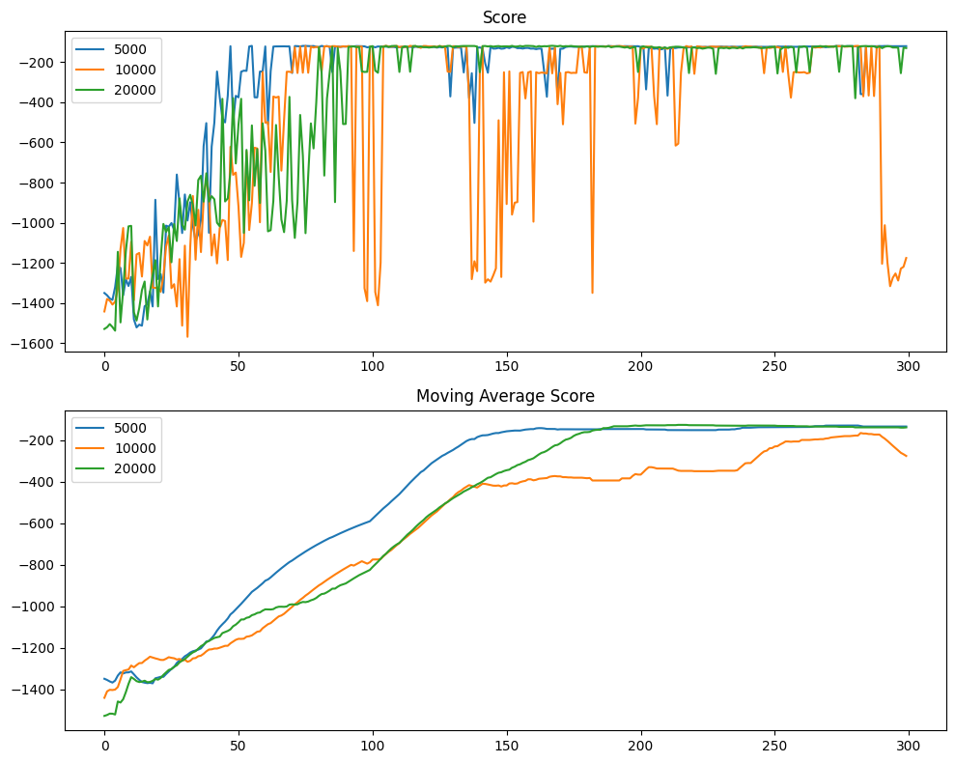
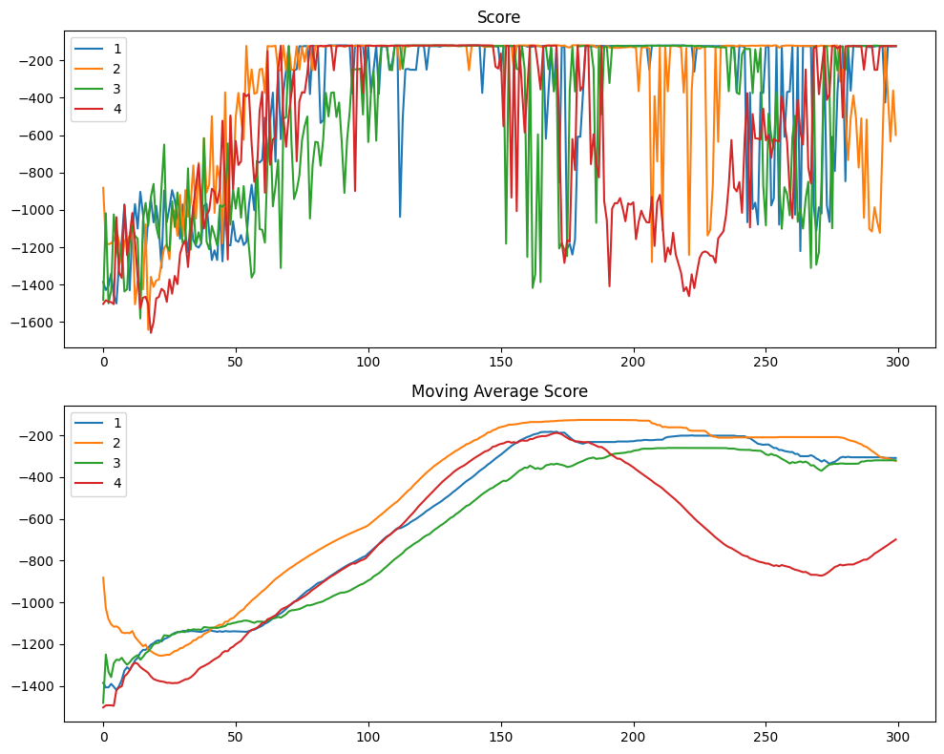
Tuning (3) - Memory Length & Update Target/Episode
MemorySize = [5000, 10000, 20000]
Update_Target_Episode = [1,2,3,4]
While 5000 seemed to converge quickly and appeared stable, further testing revealed that this instance was somewhat lucky, In contrast, 20,000 demonstrated significantly more stability in terms of memory length
Updating every 2 episodes is optimal.
Strikes a balance between frequent and infrequent updates.

Slide 26
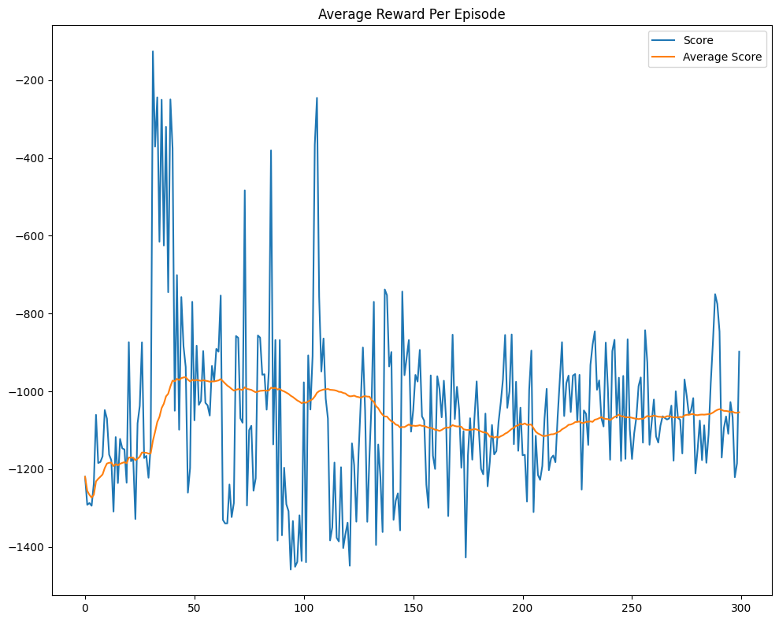
Tuning (4) - Normalized Rewards
Normalized rewards using average and standard deviation.
Increased training time significantly (5x) due to frequent mean and std calculations.
No observed improvement in learning stability. [Made it worse]
With Normalization
Without Normalization

Slide 27
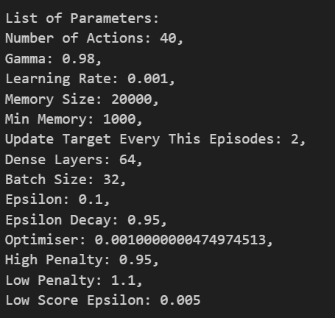
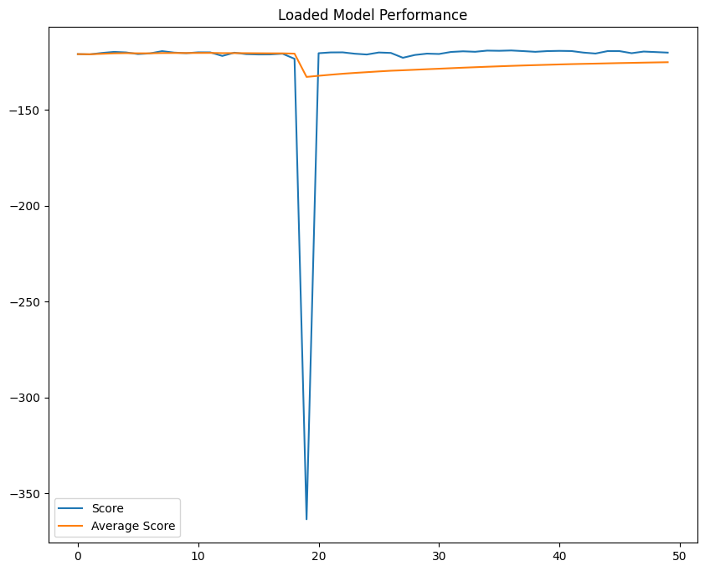
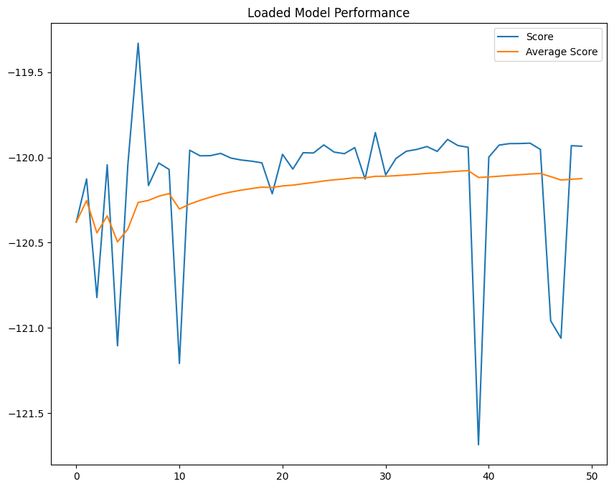
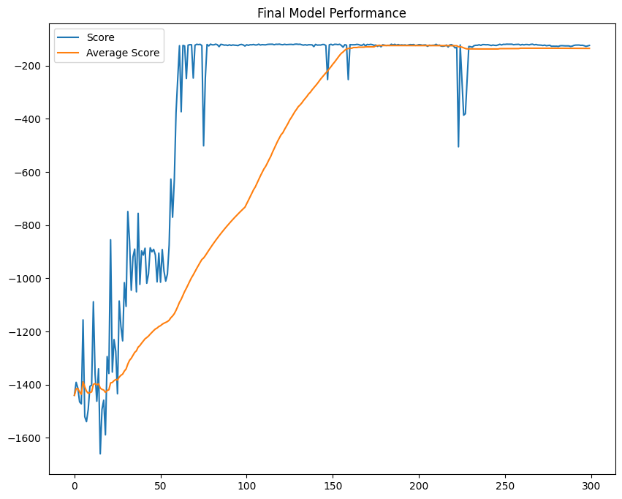
Final Model and Evaluation
Loaded Model for 50 episodes
1 Slight drop in 50 episodes, is very reasonable and I think satisfactorily demonstrates DQN’s viability in solving the “Pendulum-V0” Problem
The graph on the right, is without any memory, it’s also very stable just hovering in between -121.5 and -119.5
Only 4 Spikes, once training has stabilized
Loading it in also appears to have no problems

Slide 28
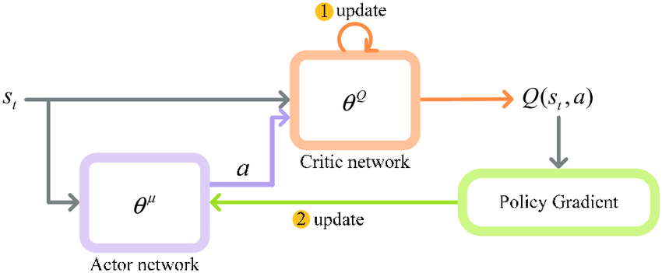
An Alternative Solution DDPG()

Slide 29
Key Differences
DQN()
DDPG()
Action Space:
Not suited for continuous action spaces, need to be discretized
Policy Representation:
Policy that maps states to discrete actions, by estimating Q-Values
Exploration
Relies on epsilon-greedy exploration
Structure: Just one Network with a Main and Target Model
Action Space:
Tailored for problems with continuous action spaces
Policy Representation:
Deterministic Policy that maps states to continuous actions. The actor directly outputs the action given to be taken in a given state
Exploration
Noise added to the action output to encourage exploration
Structure:
Uses an Actor-Critic System to Generate and
Evaluate the rewards

Slide 30
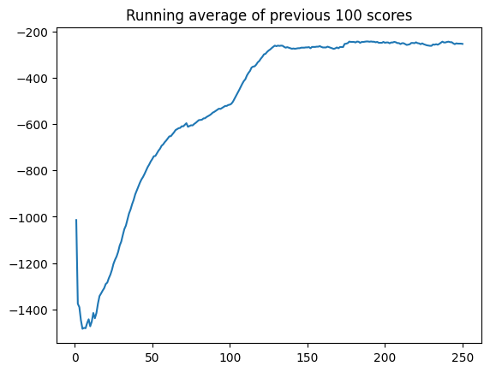
Results of base model of a not tuned basic DPGG Network:
Given, that it was not tuned for this problem, this model performs very well.
It managed to mostly stabilise after 100 Episode.

Slide 31
Thank You!
Are there any questions?
Veuillez conserver cette diapositive pour l'attribution

